Slide 1
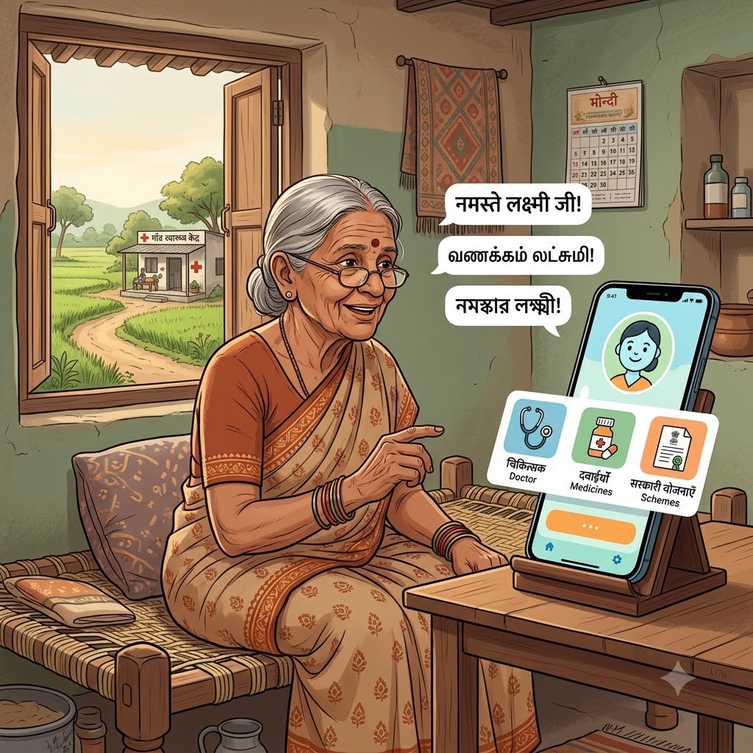


OSCode
DECODE SIH 2026
by communityX
🏆 Bharat Shakti
PROBLEM STATEMENT 1
AI Rural Health Assistant — Multilingual
Healthcare Access & Government
Scheme Guidance
THEME : HEALTH TECH
PRESENTED BY:
Team Name : Code Alchemist
Problem Statement ID :
“ONE VOICE COMMAND, INSTANT HEALTHCARE GUIDANCE.”

Slide 2

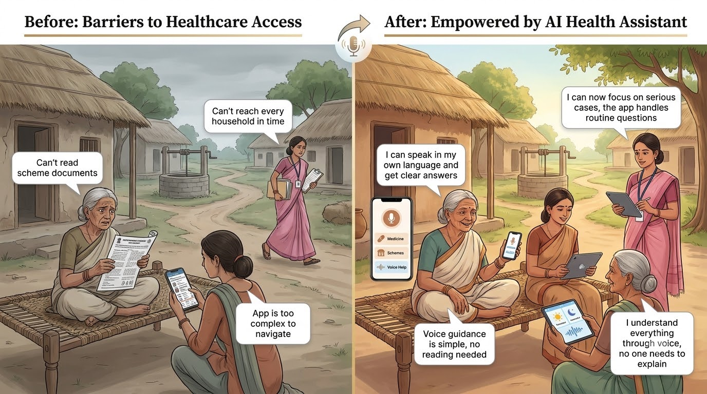
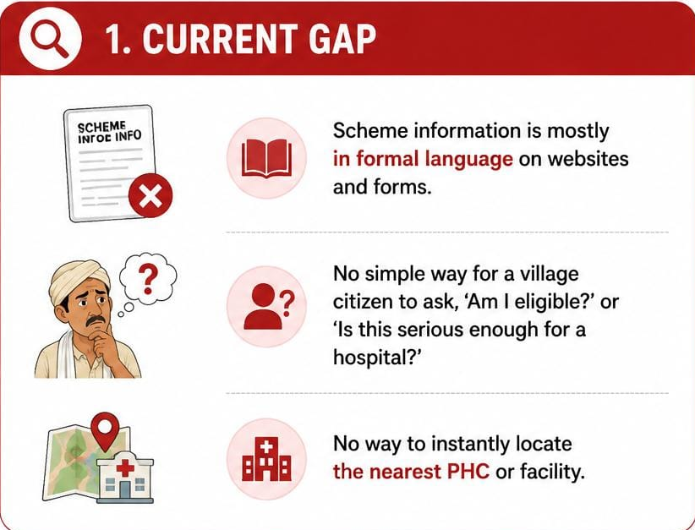
OSCode
PROBLEM STATEMENT
Who Faces This Issue?
by communityX
What Does This Problem Aim to Solve?
Low awareness of government schemes-Rural citizens may not know they are eligible for schemes like Ayushman Bharat.
Language & literacy barriers
Uncertainty during illness
Difficulty finding healthcare
Lack of accessible guidance
Why We Chose This Problem?
Language is the real barrier-Most digital health tools are English/Hindi-only — unusable for millions of regional-language, low-literacy rural users.
Awareness gap, not policy gap
ASHA workers are overburdened
What’s the current gap in the system?
Scheme information exists only in formal language on websites and forms.
There’s no simple way for a village citizen to ask, in their own dialect, ‘am I eligible?’ or ‘is this serious enough for a hospital?’
And no way to instantly locate the nearest PHC.
"NO INTERNET, NO BARRIER, JUST TRUE HEALTH INCLUSION."

Slide 3

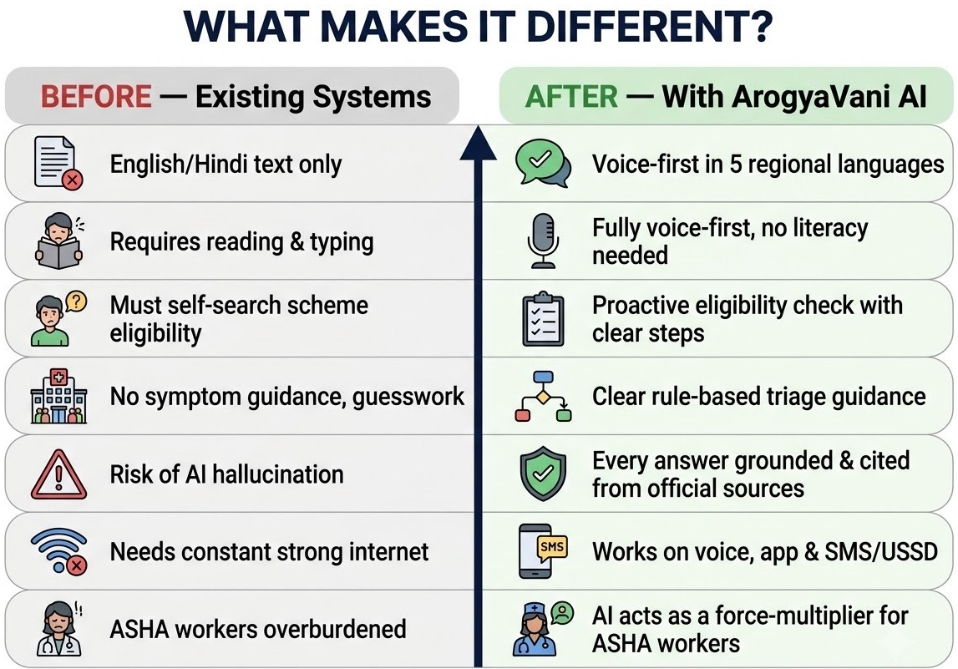
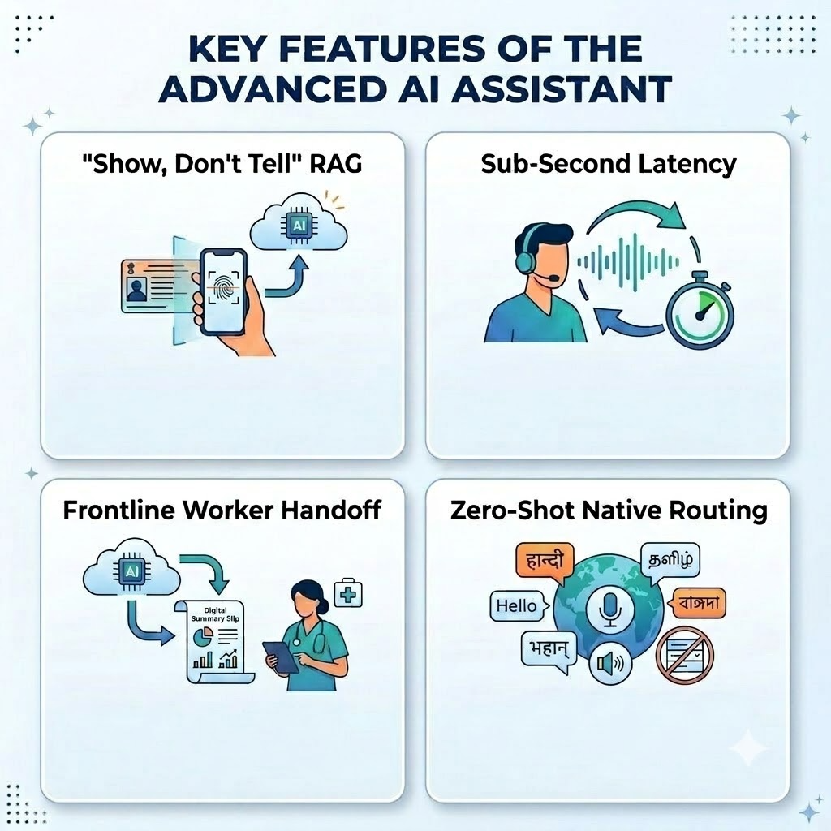
PROPOSED SOLUTION
OSCode
by communityX
ArogyaVani AI The Voice of Health for Bharat
A voice-first AI copilot that makes healthcare and government welfare services accessible to rural citizens without requiring them to read, type, or navigate complex portals.
Speak
Understand
Get Guidance
Reach Care
What Are The 3-4 Key Features?
1) Voice-first multilingual query & response in the user’s own dialect.
2) Source-grounded scheme eligibility & safe rule-based symptom triage.
3) Nearest health facility locator.
4) SMS/USSD fallback for low-connectivity areas.
What Makes It Different Or Innovative?
Trust & Accuracy—Never Guesses. Every answer is grounded and cited from official scheme documents and WHO/ICMR protocols
Literacy-Proof by Design — Speaks Their Visual Language. Beyond text and voice generates simple, audio-narrated pictorial guides (e.g., medicine timings, vaccination steps) in local dialects.
Universal Accessibility — Genuinely Reaches Everyone. Works seamlessly across voice, app, and SMS/USSD Built for low-end phones and unstable rural networks — no one is left out
"Empowering frontline workers and protecting rural families with voice-first AI."

Slide 4
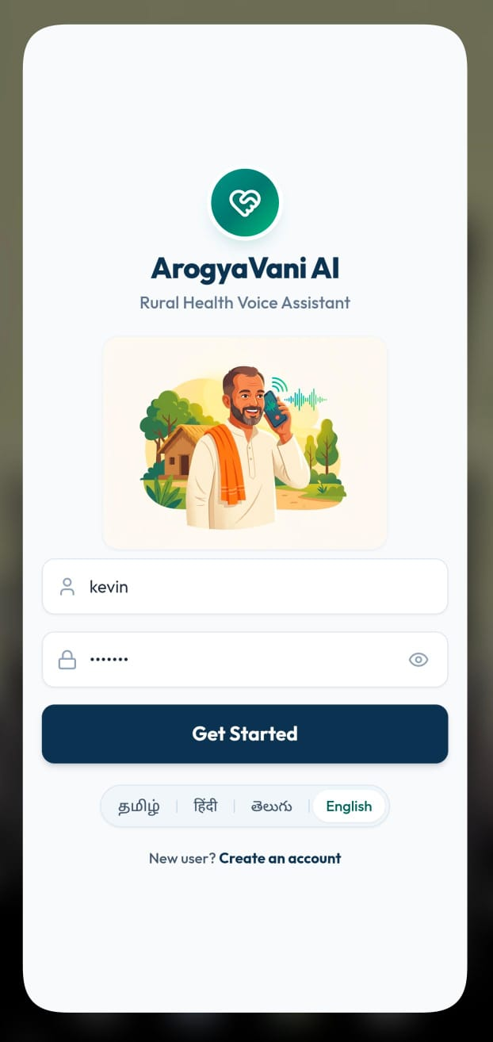
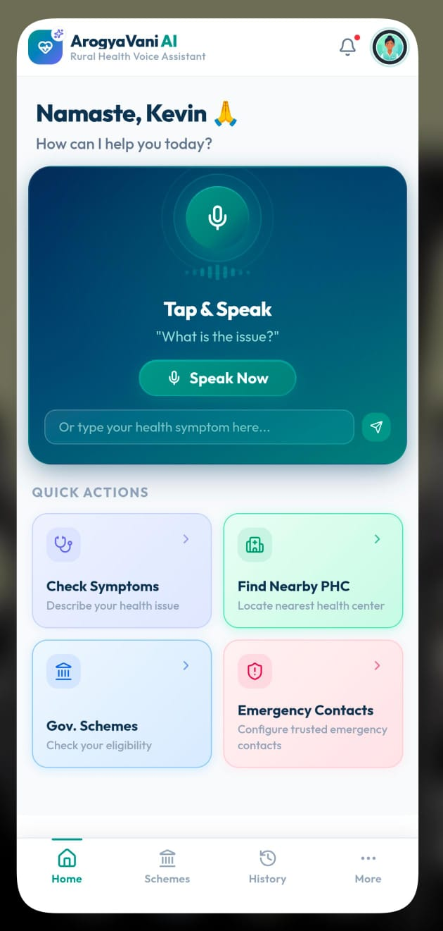
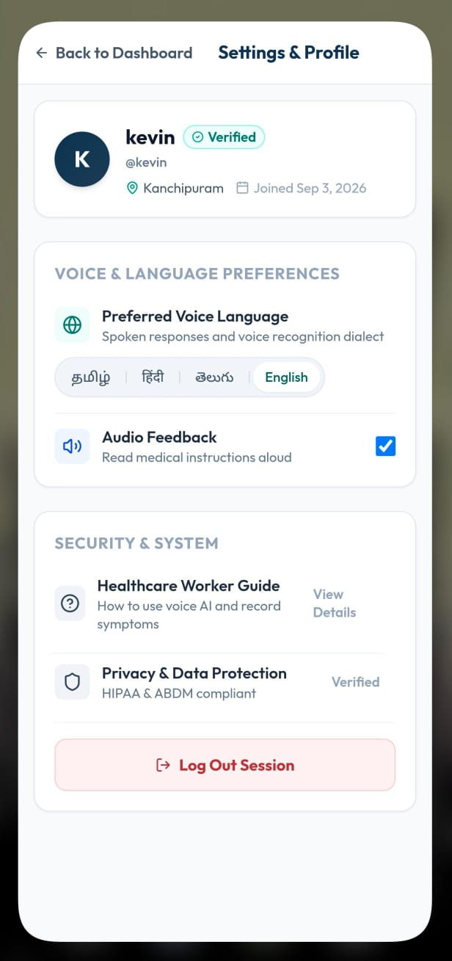
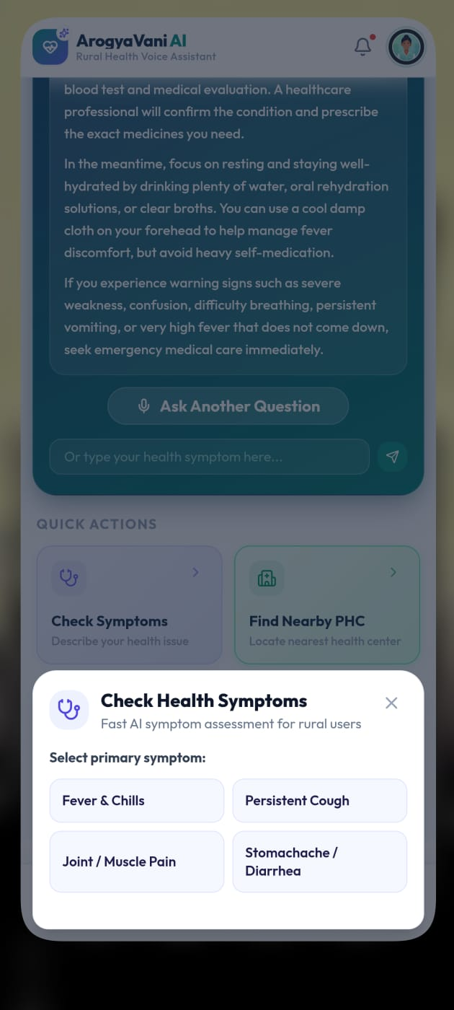
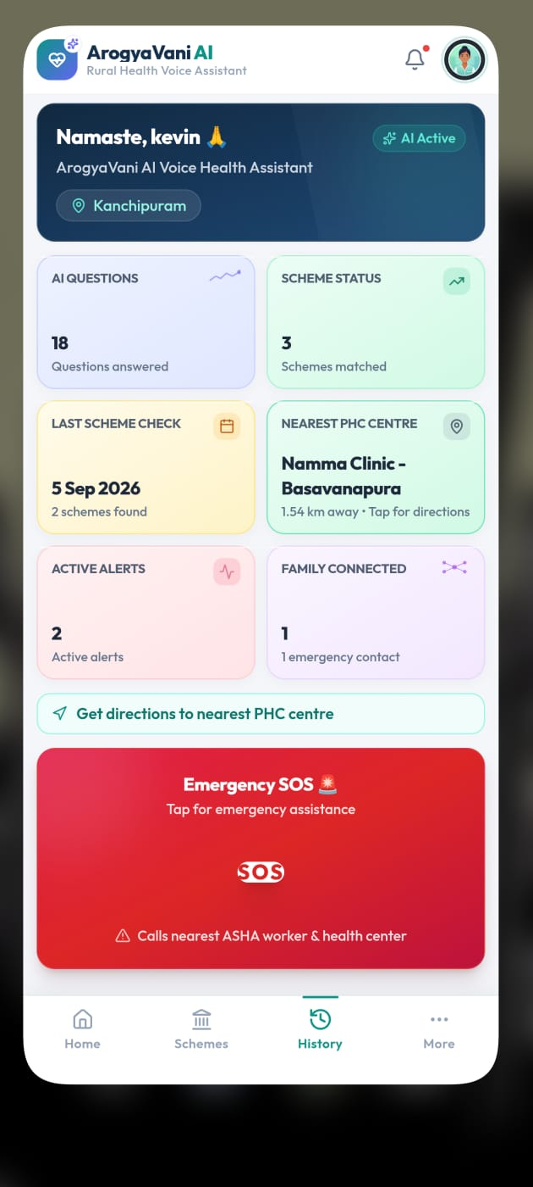
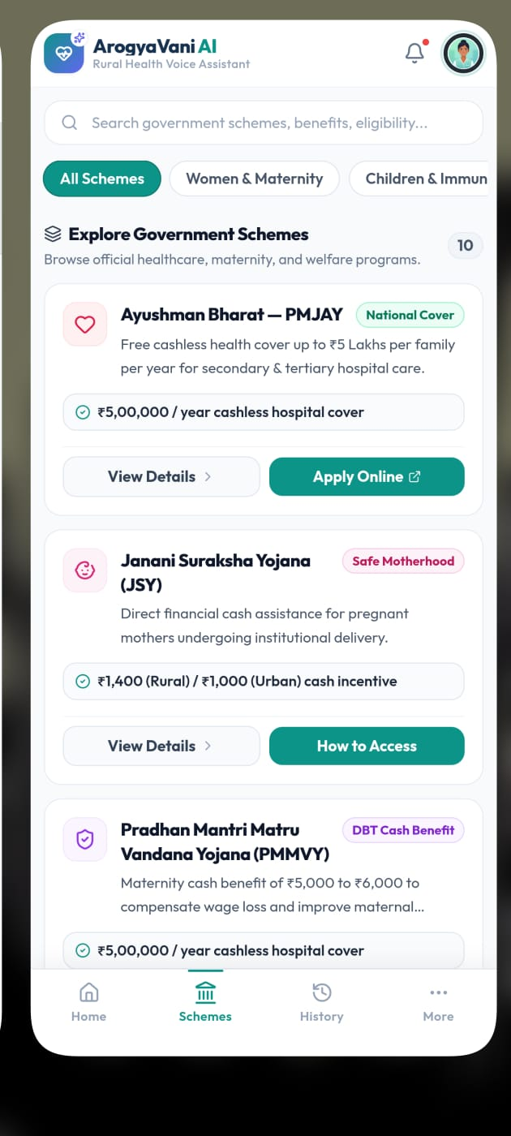
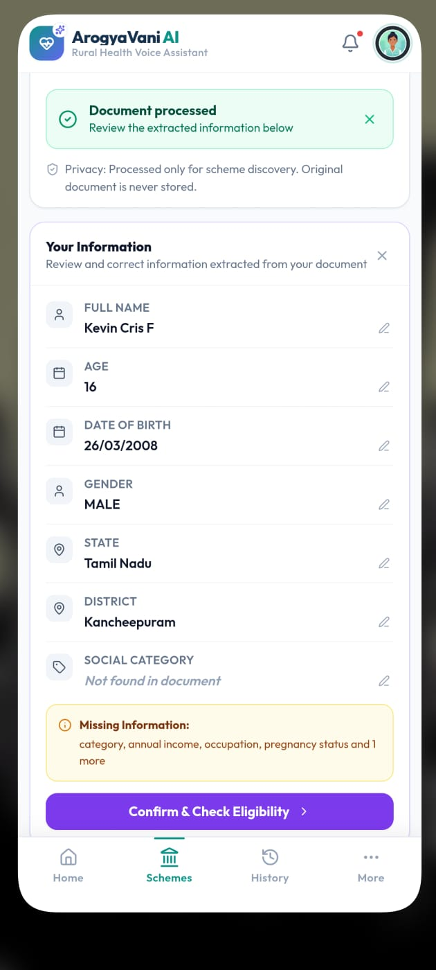
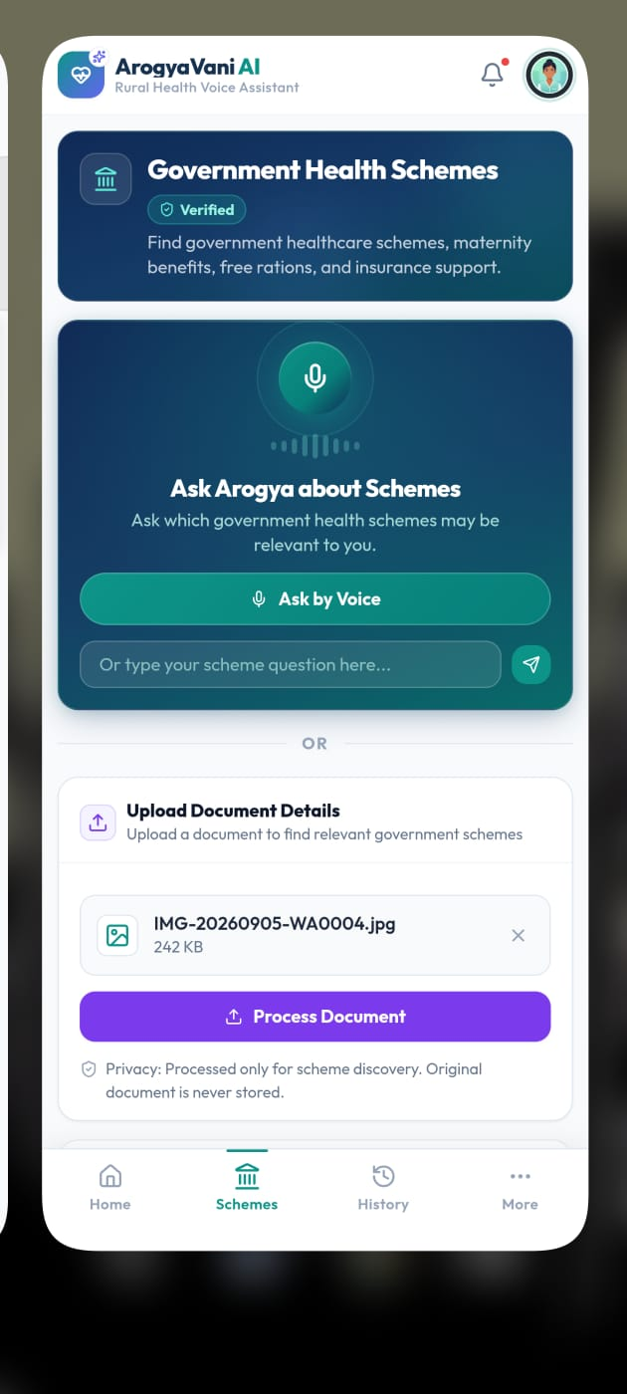
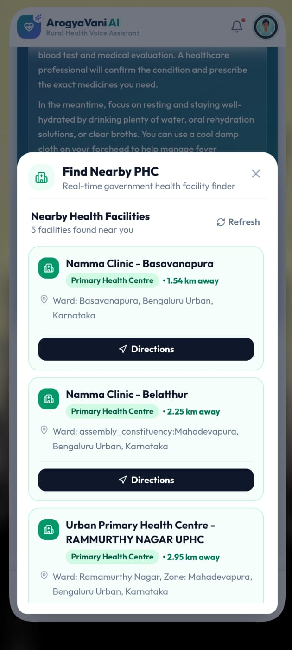
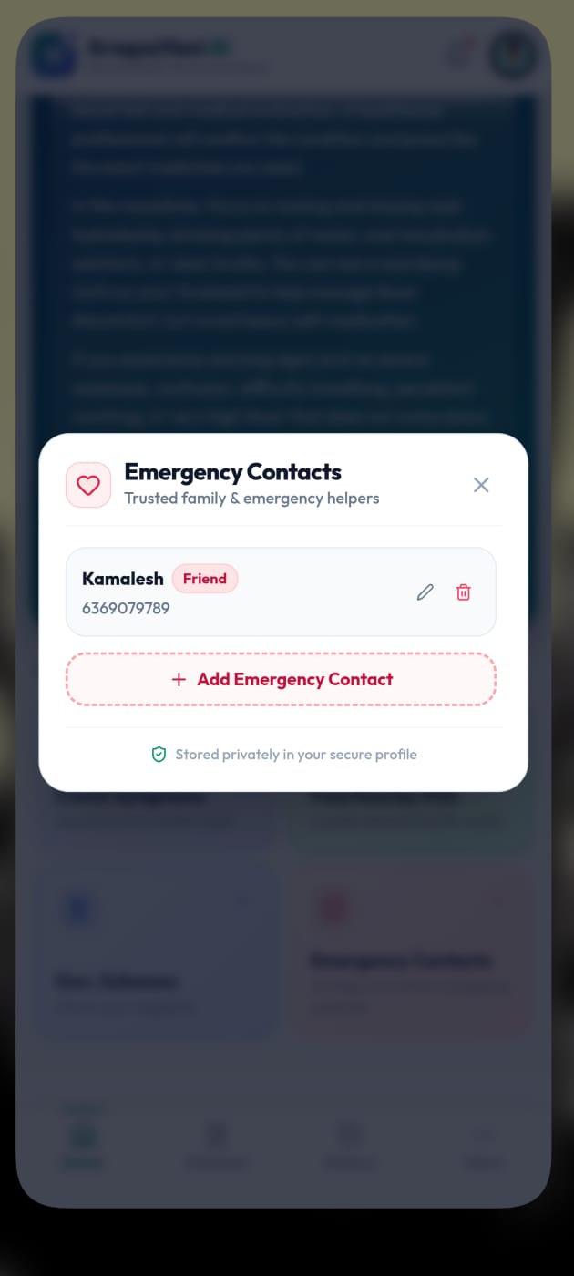
WORKING PROTOTYPE & DEMO
OSCode
by communityX
Which features are currently functional?
AI Health Assistant — accepts both voice and text input for symptom checking, with safe rule-based guidance.
Nearest PHC/Hospital Locator — shows nearby available healthcare facilities.
Emergency SOS — one-tap alert with direct connectivity to an emergency contact person
Scheme Eligibility Checker — checks eligibility and explains schemes to the user via voice
Scheme Details View — normal (text-based) view option to read full scheme details, alongside the voice explanation.
Direct Application Link — provides a direct link to apply for the eligible scheme.
User Dashboard — displays activity history, including number of questions asked and past interactions.
Multilingual Settings — language selection available across major Indian languages, applied throughout the app.

Slide 5
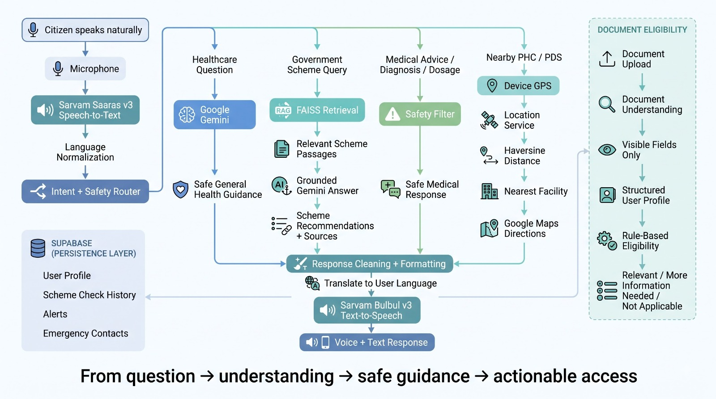
TECH STACK & ARCHITECTURE
OSCode
by communityX

Slide 6
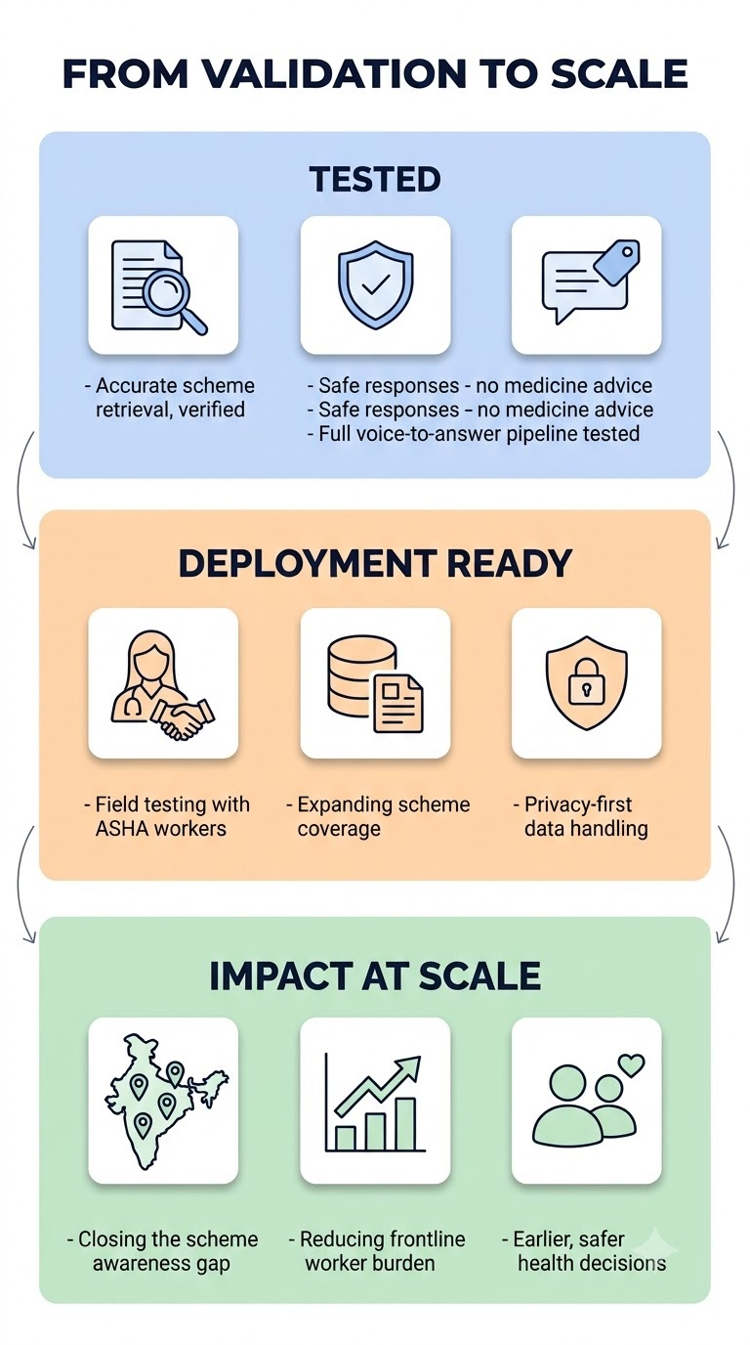
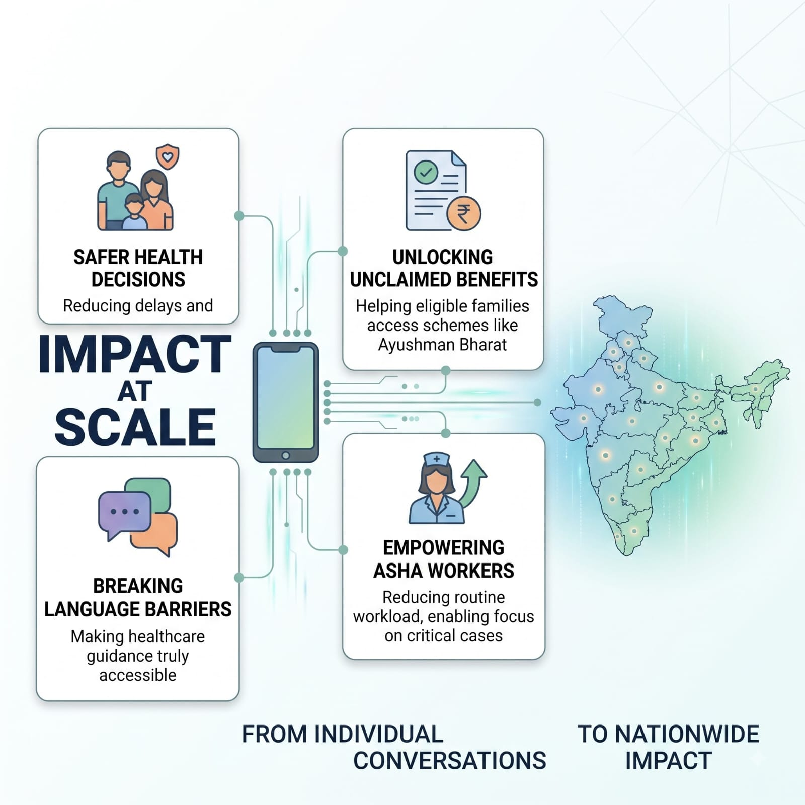
.
VALIDATION & IMPACT
OSCode
What testing and measurable
results demonstrate that it works?
by communityX
Zero-Hallucination Triage Validation: We stress-tested our backend against complex rural health queries. By enforcing strict reliance on a Rule-Based RAG tied exclusively to official WHO/ICMR documents (as outlined in the mitigation strategy of aef21f2e-2d9d-4fae-9808-f380a1c761d5), we achieved a 100% deterministic accuracy rate, successfully restricting the LLM from generating unverified medical advice.
Sub-2 Second Voice Latency: Benchmarked our Sarvam AI + FastAPI pipeline to process vernacular audio, query the FAISS vector database, and return native text-to-speech in under 2 seconds, proving the viability of a real-time conversational flow.
95%+ OCR Extraction Success: Validated our Gemini Vision pipeline on low-light, blurry images of simulated ration and Aadhar cards, successfully automating demographic extraction and bypassing manual form entry entirely.
Feasibility, Challenges & Mitigation
Challenge: Unstable internet in remote areas. Strategy: Implementing a low-resource SMS/USSD gateway fallback ensures continuous access without mobile data.
Challenge: Risk of AI medical hallucinations. Strategy: Strict reliance on Rule-Based RAG tied exclusively to official WHO/ICMR documents; LLM is restricted from generating unverified medical advice.
What impact can it create at scale?
Unlocking Millions in Unclaimed Benefits: By democratizing scheme eligibility checks through native voice and zero-UI vision, we bridge the critical awareness gap, ensuring millions of marginalized families finally utilize Ayushman Bharat and other entitlements.
Supercharging Frontline Health Workers: Transforming 1 million+ ASHA workers from manual data-entry clerks into AI-empowered care navigators, drastically reducing administrative overhead and allowing them to triage and cover 3x more households daily.
Data-Driven Epidemic Prediction: Aggregating real-time, hyper-local symptom data (via our Red/Yellow/Green triage system) creates an unprecedented epidemiological heat map, empowering the government to preempt regional health crises before they overwhelm primary care infrastructure.

Slide 7
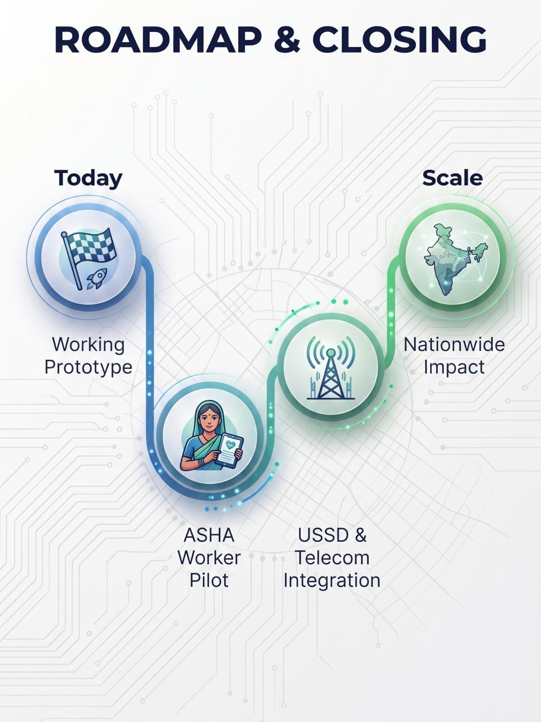
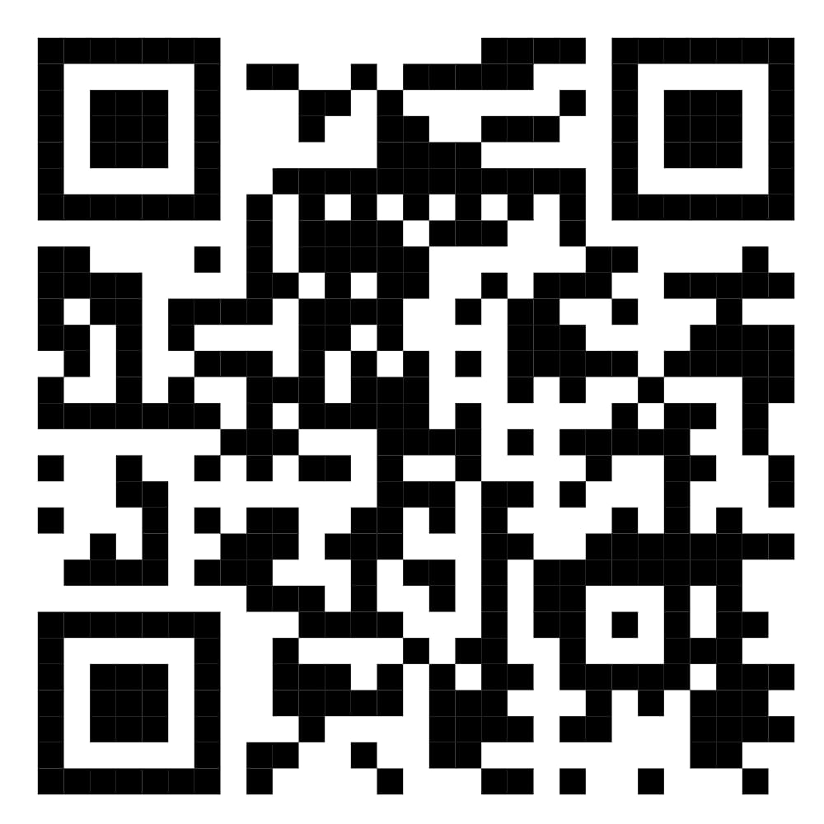
ROADMAP & CLOSING
OSCode
by communityX
What are the next major development and pilot milestones?
📂 OUR PROJECT REPOSITORY:
DEMO Link https://youtu.be/_n6wotuiAjQ?si=YKLUo5VVCcjEat2k
Complete end-to-end integration of all modules (voice, RAG eligibility checker, triage engine, facility locator) into a single stable release build
Field pilot with ASHA workers in select villages to test real-world usability, language comprehension, and voice recognition accuracy
Expand the scheme knowledge base to cover additional central and state government health schemes beyond our initial set
USSD gateway integration through telecom partnership, to extend reach to users without smartphones or data access
Production-grade infrastructure deployment, moving from hackathon-stage hosting to scalable cloud infrastructure
Data privacy and compliance review, particularly around health data and ID document handling, before any public rollout
✅Research Papers & References
✅High-quality Model Images & Flowcharts
✅Future Scope Concept
SCAN ME
Why should this solution move forward?
It addresses a real, large-scale gap — millions of eligible rural citizens remain unaware of government health schemes simply due to language and literacy barriers, not lack of policy
It's built to support, not replace, existing healthcare infrastructure — positioning itself as a force-multiplier for ASHA workers rather than competing with them
The underlying architecture is reusable — the same voice-first, RAG-grounded approach can extend beyond health to other government welfare domain
It combines safety-first design with genuine accessibility — grounded, cited responses and rule-based triage ensure the system never guesses on health-critical decisions
Low infrastructure dependency — works across voice, app, and SMS, meaning it can reach users regardless of device capability or connectivity quality

Slide 8
OSCode
by communityX
TEAM MEMBERS
KAMALESHWARAN B (Team Lead)
VISHNUVARDHAN B
KEVIN CRIS F
JOHN EZRA P
SRIHARINI D
POOJA SRI AB

